Slide 1
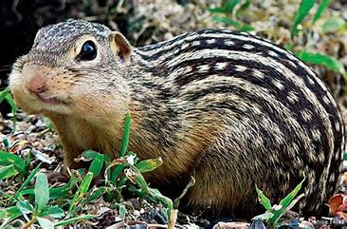
Collaboration
Shotgun study:
The effect of hibernation on the squirrel platelet proteome
Notes:
This was a collaboration with Dr. Scott Cooper at the University of Wisconsin - La Crosse. It also involved Dr. Joe Aslan at OHSU, our resident platelet expert. Blood platelets were collected from 13-stripe ground squirrels before, during, and after winter hibernation.

Slide 2
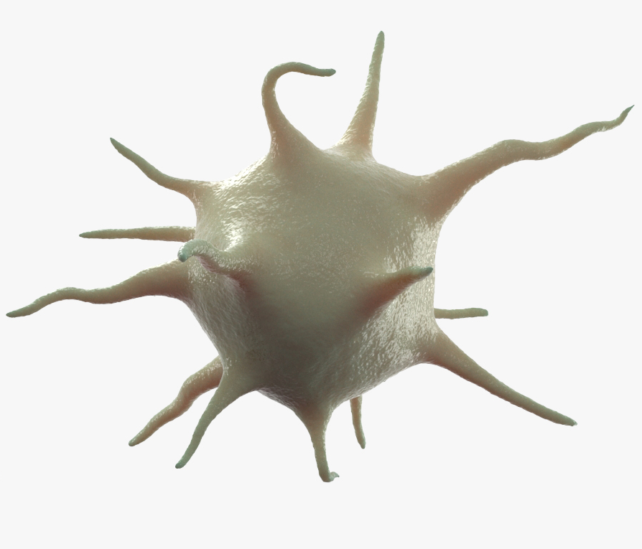
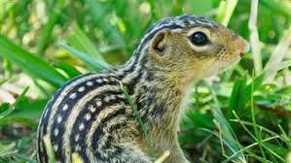
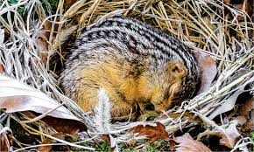
Does the platelet proteome change during hibernation? Background and study design
PRE
Platelets are blood cells involved in forming clots to stop bleeding
Blood platelets were collected from four 13-lined ground squirrels
At the time of the experiment, limited to 11 TMT channels
-4 pre-hibernating
-4 hibernating
-3 post-hibernating
Hibernating
POST
Notes:
There are many physiological changes that must occur hibernation. Little is known about most of them. A main function of platelets is to clot blood and hibernating animal blood does not clot. Are there any protein expression changes in the platelet proteome during hibernation? We can use isobaric labeling (also known as tandem mass tagging or TMT) and mass spectrometry to perform large-scale protein expression profiling.

Slide 3
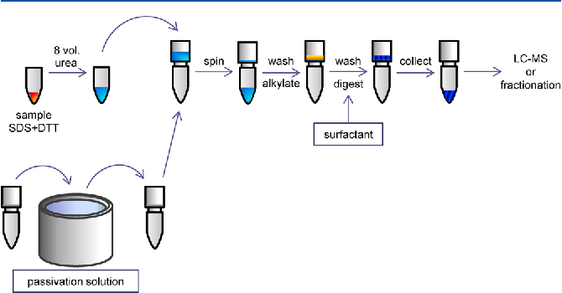
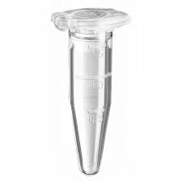
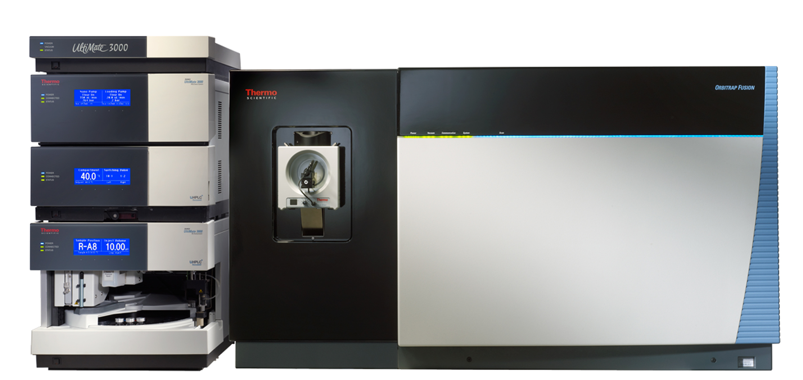
eFASP workflow for squirrel platelet samples
3. Buffer exchange to remove SDS
5. Buffer exchange to remove urea, IAA
2. Add urea
7. Collect peptides
1. 60 ug sample in SDS, DCA, TCEP
4. Alkylate with IAA
6. Add trypsin, digest overnight
8. Phase transfer to remove DCA
> 3000 proteins
9. TMT label and 2DLC analysis (36 hours)
Modified from Erde, J., Ogorzalek Loo, R.R., Loo, J.A. J. Proteome Res. 2014, 13, 4, 1885-1895
Notes:
TMT involves chemical reaction of peptides (not proteins) with special reagents. We first have to digest the proteins with trypsin and remove any buffer chemicals, like SDS and salts, that might interfere with the mass spectrometer. We have to reduce disulfide bonds (and block the cysteines) and denature the protein to digest with trypsin. Once we have peptides, we can label them with TMT reagents. We use liquid chromatography to spread out the complex peptide mixture and give the instrument time the measure the peptides.

Slide 4
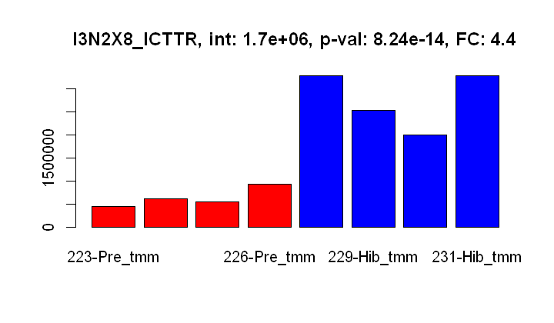
Pre-hibernating vs Hibernating
Each reporter ion signal is the sum from all peptides belonging to kininogen
4.4-fold increase
128C
130N
129N
129C
Reporter ion signal
128N
126
127N
127C
Pre-hibernating
Hibernating
Kininogen is a protein involved in blood coagulation
Notes:
We had 11 TMT reagents available (11-plex) when the experiment was done. There are now 16-plex reagents and we have methods to use more than one plex in a study. Each reagent that labels a particular biological sample has a unique low mass reporter ion that get liberated during the mass spectrometry. Here we see the reporter ions for one protein’s peptides for the pre-hibernation (in red) and hibernation samples (in blue). This protein has increased expression during hibernation.

Slide 5
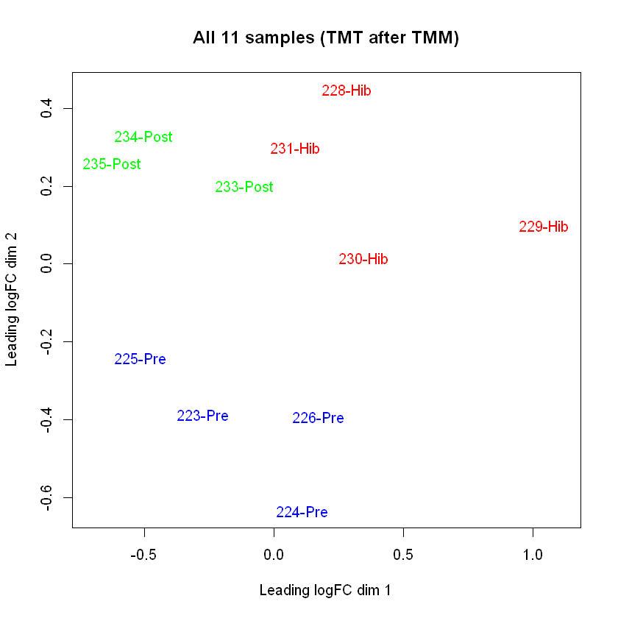
Do the samples cluster by condition?
Notes:
Clustering views are a way to see if the experiment worked like we imagined. We might expect that the biological replicates within each condition would be similar to each other. If we have protein expression differences between groups, then we expect the clusters for each condition to be separated from each other. We can see that the blue cluster, the red cluster, and the green cluster are distinct.

Slide 6
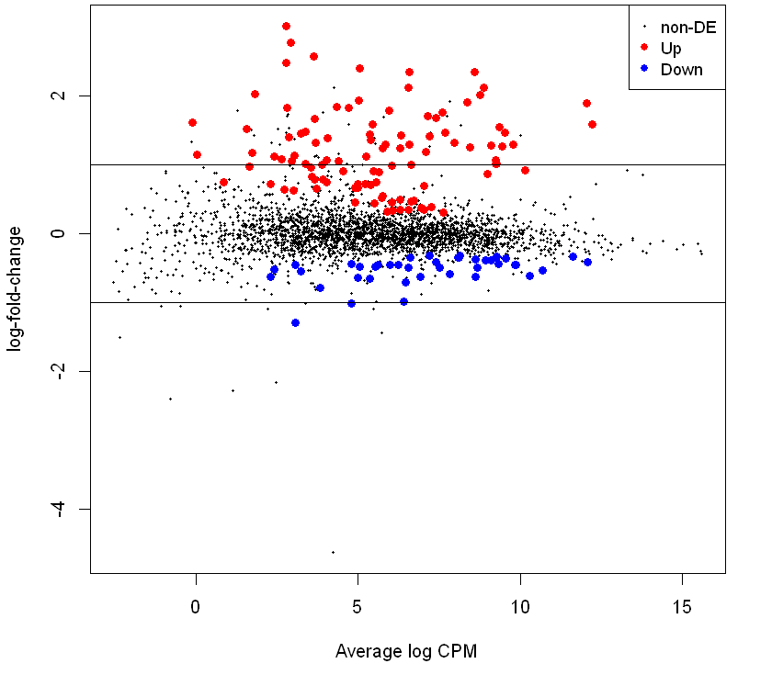
Pre-hibernation vs hibernation: are there any proteins with significant differences?
3038 proteins IDed
FDR: 0.05
Up 104
NotSig 2893
Down 41
Notes:
We use statistical modeling to test the expression levels of each protein to see if they are the same between conditions or different. Here we have an MA plot where the x-axis is a measure of the protein abundance and the y-axis is the expression fold-change (log2 scale). The black horizontal band are the proteins whose expression was unchanged. The red proteins were over-expressed in hibernating squirrel platelets. The blue proteins were down regulated.

Slide 7
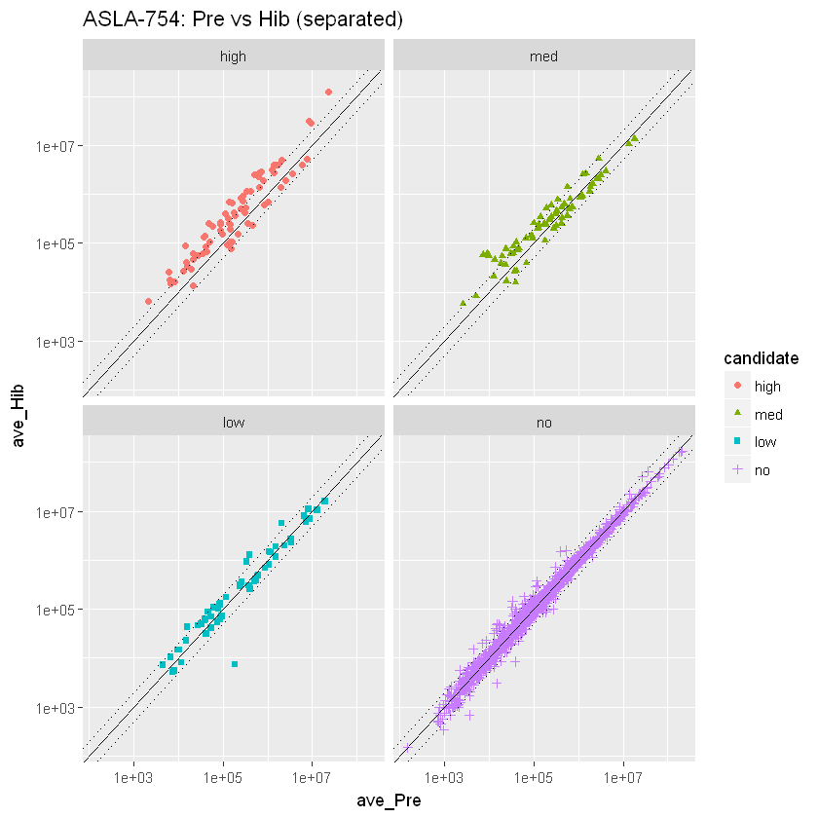
Do any of the protein candidates exhibit large differential expression?
High
Med
104 Up
41 Down
FDR <0.01
FDR 0.01-0.05
Low
No
FDR 0.05-0.1
FDR >0.1
Notes:
There are many different ways to visualize results. Here we have protein intensity scatter plots. The statistical test p-values are converted to false differential expression rates with the Benajimini-Hochberg multiple testing correction. We have used some FDR significance cutoffs to rank proteins into three DE candidate categories and the non-DE category. We have many high and medium DE candidates with more than 2-fold changes. Most of the non-DE proteins (lower right in purple) have less than 2-fold changes.

Slide 8
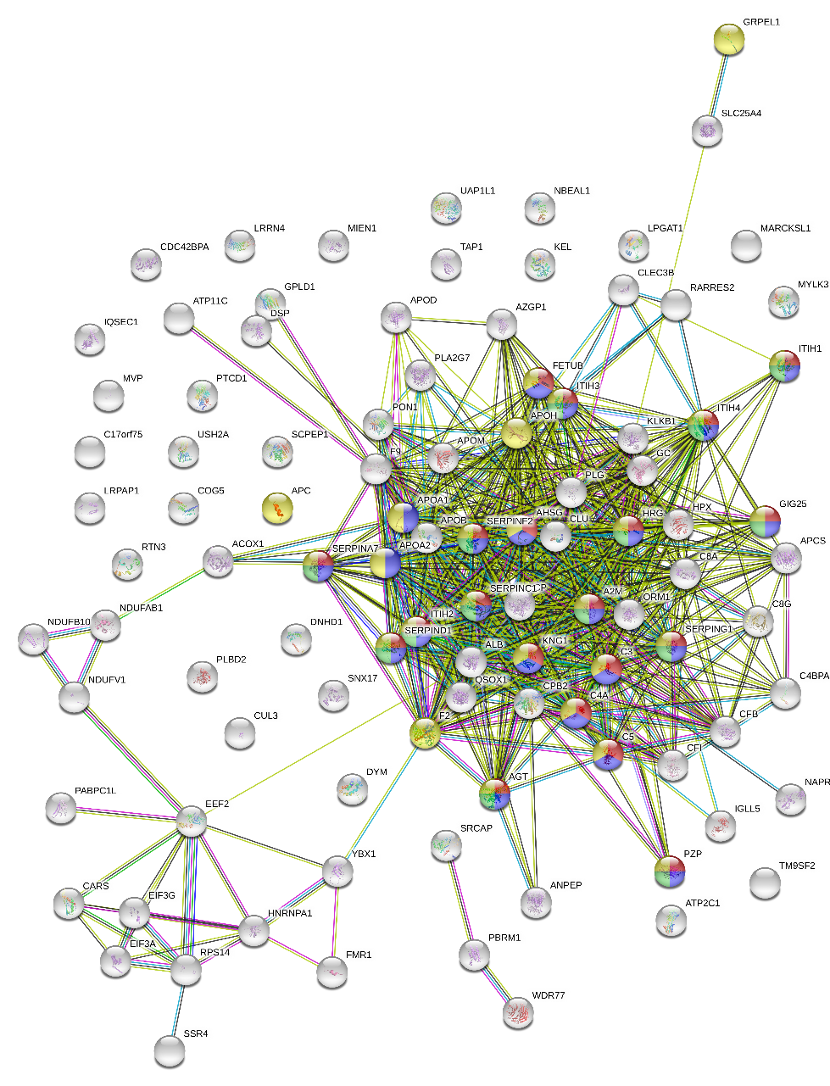
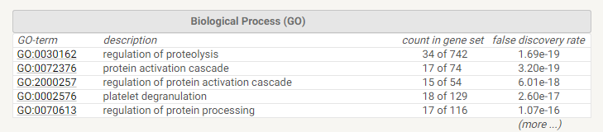
String: What was “up” from pre-hibernation to hibernation
Lists GO terms for:
-biological process
-molecular function
-cellular component
Notes:
We can take the differentially expressed proteins and see what known functions they have and what pathways they are involved in. Not much is known about squirrel proteins, but a lot is known about human proteins. We can compare the squirrel protein sequences to human sequences using BLAST to find ortholog relationships. We can then do functional and pathway analysis using the information from the human orthologs.

Slide 9
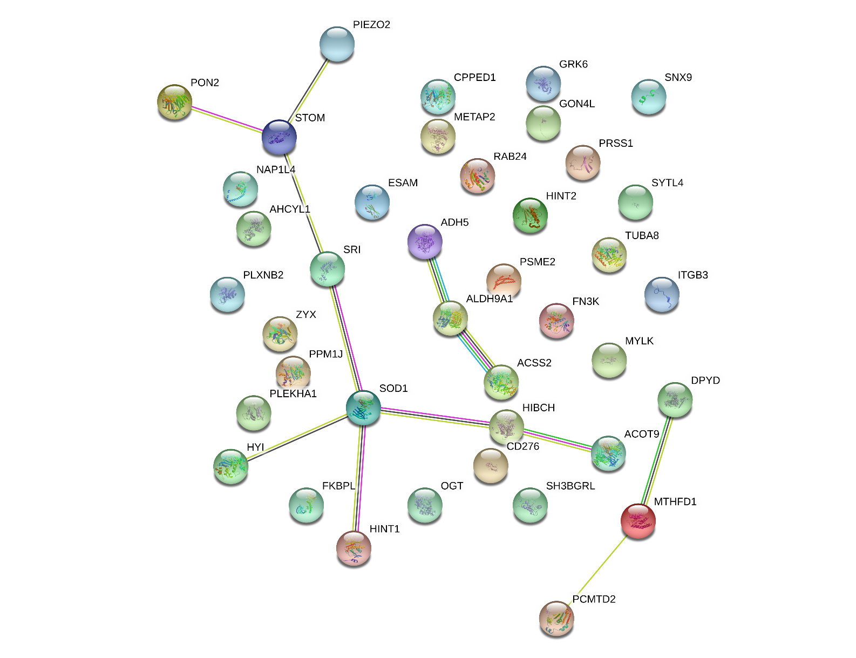
String: What was “down” from pre-hibernation to hibernation
Notes:
We see a richer, more complicated network for up-regulated proteins compared to down-regulated proteins.

Slide 10
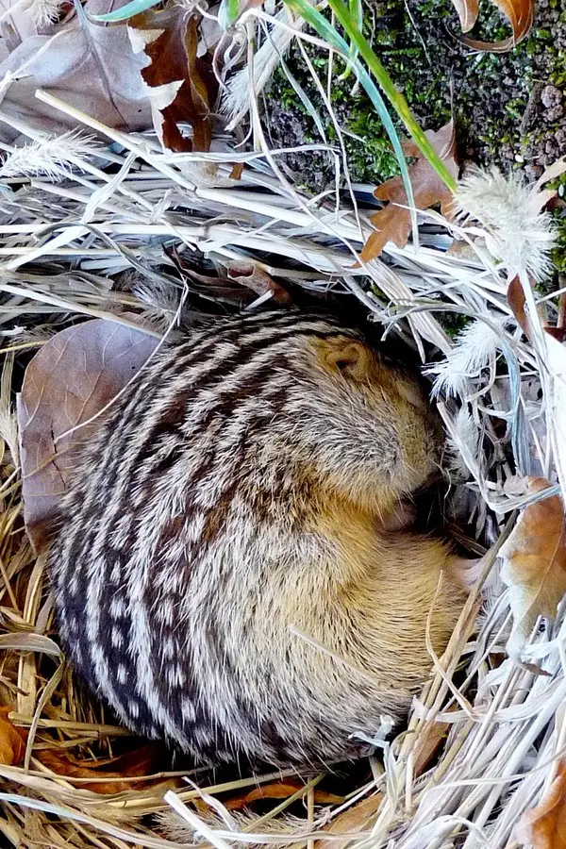
Results from 2D TMT analysis
Over 3000 proteins identified in squirrel platelets
Sample clustered well by type and many differentially expressed candidates were identified
String analysis revealed possible pathways that are involved in hibernation
Notes:
We were able to identify and quantify over 3000 squirrel platelet proteins. We had different expression patterns in each of the 3 conditions that were apparent from the cluster plot. We could test the proteins for differential expression and identify the proteins that were differentially expressed. We could use ortholog mapping and leverage human protein annotations to understand the functional and biological process changes associated with the hibernating ground squirrel platelet proteome.

